Slide 1
Embedded Systems Orientation Phase
Introduction

Slide 2
Learning outcomes
You develop and program interactive embedded systems with sensors and actuators using different I/O programming techniques.

Slide 3
Teachers
Gerald Hilderink room 2.42 g.hilderink@fontys.nl
Jaap Geurts
Sabina Pencheva
Stan van Hartingsveldt
Qin Zhao
Xuemei Pu

Slide 4
Course Structure - Orientation Phase
Week 1-6 and 7-12  two half days per week
Lessons
Exercises
Week 6 and 12
Assessment weeks

Slide 5
Course Structure – Advanced Phase
Week 13-16  two half days per week
Lessons & assignments (60% time)
Project & workshops (40% time)
Week 17-18
Assessment week
Final delivery of projects:
product
documentation
presentation

Slide 6
Week Overview
Introduction to Arduino Sketch
Introduction to Rich-Shield
Introduction to Programming
Communication
Examples
Notes:
Boring because context is not given yet → hidden for now, the Week Overview will come back after the introduction.

Slide 7

Embedded Systems are Everywhere

Slide 8
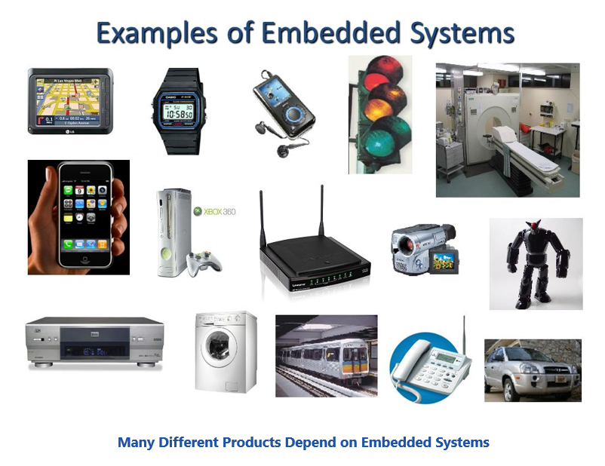
Embedded Systems
What is an Embedded System?
An embedded system is a controller with a dedicated function embedded within a larger mechanical or electrical system to automate real-time processes. This is a device including hardware, software and mechanical parts.
Notes:
Can you think of an embedded system (not in the picture) that you are using in your daily life?
Is a laptop or desktop computer an embedded system? Answer: no, it’s not part of a device or apparatus.
Is your smartphone an embedded system? Answer: no, same reason as for laptop, but it can communicate with an embedded system via an app.

Slide 9
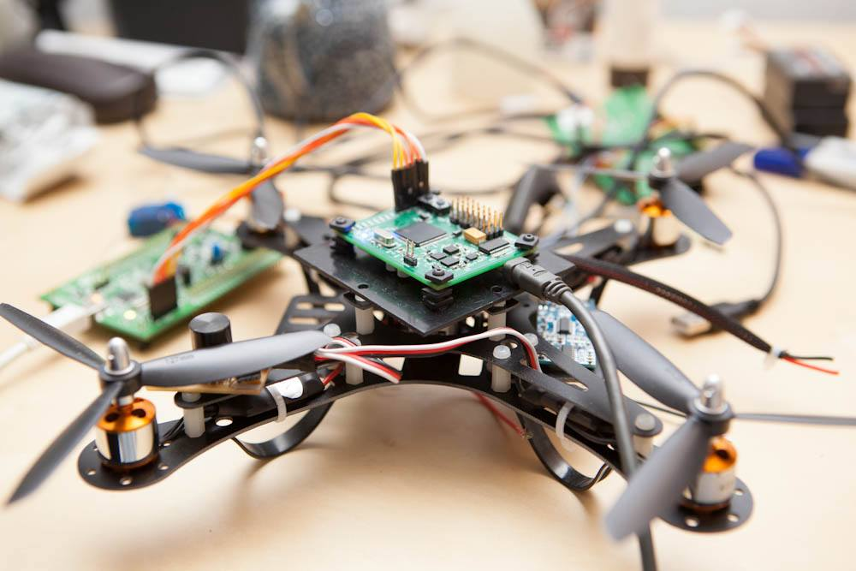
Embedded Systems
What is Embedded System Engineering?
Embedded System Engineering is multidisciplinary field of expertise required to automate processes with embedded systems.
It consists of
Software engineering
Computer engineering
Electrical engineering
Control engineering
Physics
Notes:
Use picture to imagine the multiple disciplines on a drone.

Slide 10
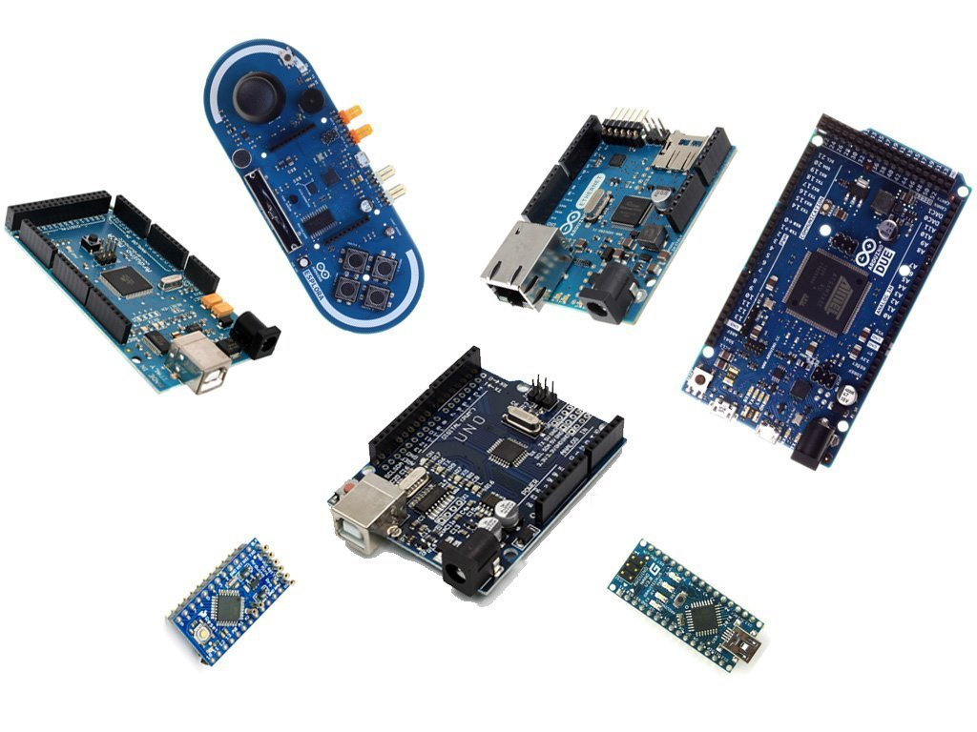
Arduino
We will use the Arduino platform at the heart of the embedded systems we are going to develop in this course.
The Arduino is a cheap and easy-to-learn platform, and conceptually similar to industrial Embedded Systems.
There are several types of Arduinos available from tiny, small, compact to large.
- Uno, Leonardo, Mega, Nano, Mini, Tiny and more

Slide 11
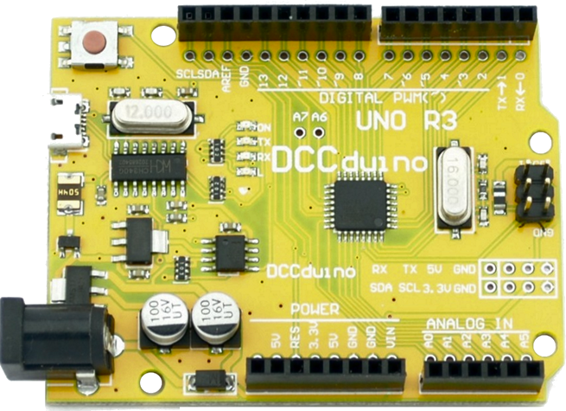
Arduino
What is Arduino?
“Arduino is an open-source electronics platform based on easy-to-use hardware and software. It's intended for anyone making interactive projects.”

Slide 12
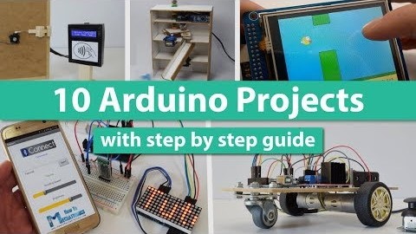

Slide 13
Arduino – Hardware
General Purpose Input Output (GPIO) headers (R3)
Reset button
LEDs
USB port
Serial port electronics
Serial port electronics
Microcontroller + memory
External power port
Power electronics
GPIO headers (R3)

Slide 14
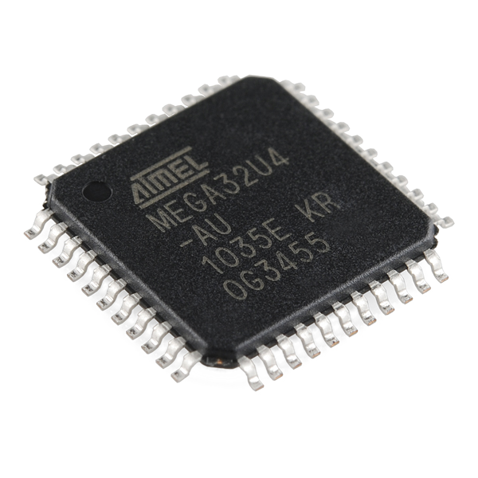
Arduino – Microcontroller
Small computer on a single Chip
Energy efficient microprocessor (CPU)
Programmable memory
Serial ports (one USB for programming)
I/O pins to connect sensors and actuators
Special features on Chip (advanced)
Many Arduino boards with different types of microcontrollers available with different speeds, capacities and features.
Notes:
No external devices:
No keyboard
No mouse
No screen

Slide 15
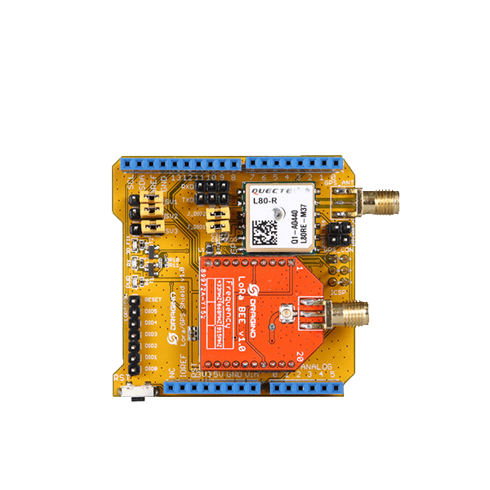
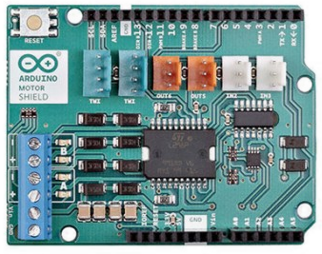
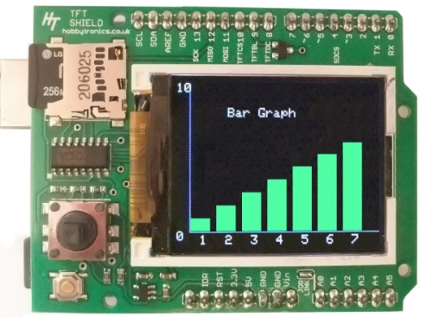
Arduino – Shields
Arduino supports many different types of additional modules called “Shields”.
Motor control (3D printer)
Data monitoring
Internet of Things

Slide 16
Arduino – Programming
Let’s learn how to program the Arduino in C

Slide 17
Arduino – Programming
Arduino needs a program to work.
The place to find information and tools is www.arduino.cc
We use the Arduino IDE tool to write, build, upload and debug programs.
❶ Download and install the Arduino IDE (download) from the www.arduino.cc website on your laptop ...
IDE = Integrated Development Environment

Slide 18
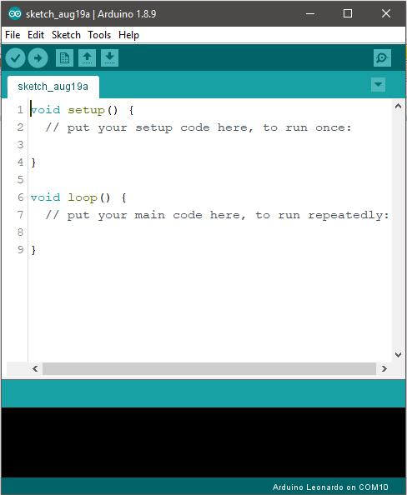
Arduino IDE
❷ Plug in your Arduino in the USB port … (you hear a bleep)
❸ Start the Arduino IDE …

Slide 19
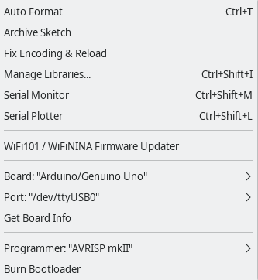
Arduino IDE – Setup
Connect the Arduino to your laptop using the USB cable.
Set up:
❹ Tools  Board  Leonardo or Uno
❺ Tools  Port  Arduino com port
❻ Tools  Programmer  AVRISP mkII
Important! Select the right board!

Slide 20
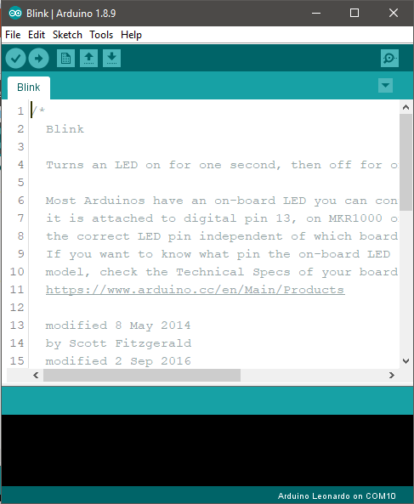
Arduino IDE – Blink demo
Select:
❼ File  Examples  01.Basics  Blink
The Blink example loads in a new editor.
Build and upload the example:
❽ Press and observe the LEDs on Arduino
If the LED blinks on the Arduino then it’s OK otherwise troubleshooting…
Notes:
Show students how to start Arduino, configure it and run the first blink example demo.
Show them how to copy the rich-shield library and examples

Slide 21
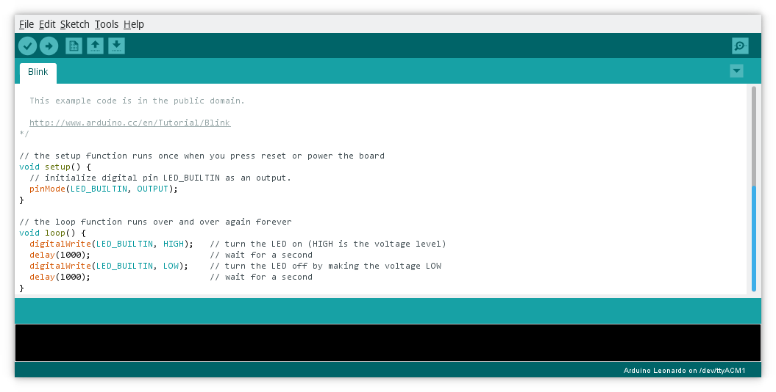
Arduino IDE – Blink demo
Notes:
Show students how to start Arduino, configure it and run the first blink example demo.
Show them how to copy the rich-shield library and examples

Slide 22
Arduino IDE – New Sketch
❶ Start a new Sketch …
structural characters
keywords
comments
Syntax highlighting improves readability
Notes:
Discuss the code example. Explain the functions setup() and loop(). Explain highlighting, keywords, structural characters (braces), comments, and the place to put in your code.

Slide 23
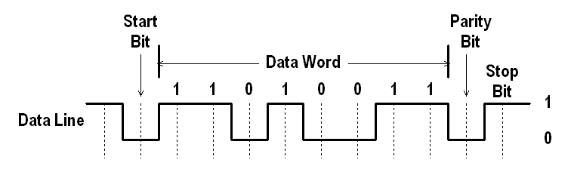
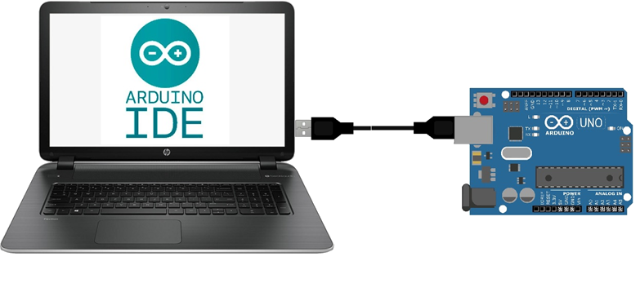
Serial communication
Serial communication passes the characters one-by-one with a pattern of serial bits
Electrical signal combining clock (baud-rate) and data
USB
Information is transmitted as zeros (‘0’) and ones (‘1’) …. also known as bits.

Slide 24
Serial communication
The laptop and Arduino communicate via the USB cable (Universal Serial Bus)
Powers the Arduino (+5V, 0V)
Upload program to the Arduino
Send messages to the Arduino
Receive messages from the Arduino
It’s useful to send feedback of the program state on the Arduino to the serial monitor on the laptop  to solve run-errors (=debugging)

Slide 25
Serial communication
void setup()
{
// Set serial speed
Serial.begin(9600);
}
void loop()
{
// Send a string to the serial monitor
Serial.print(“Hello World!");
}
Use previous sketch or create new
❷ Edit the program
❸ Build and upload the program
❹ Open the serial monitor (baudrate must be 9600)
❺ What do you see?
❻ Replace print into println
❼ Repeat steps 3..5

Slide 26
Serial Communication – Getting feedback
void setup()
{
Serial.begin(9600); // Serial speed
// … your code here
Serial.println(“Initialized”); // send state
}
void loop()
{
// … your code here
Serial.println("It's working"); // send state
}

Slide 27
Programming – Basic steps
Create new sketch
Load example
Load existing sketch
or
or
Start
No, improve program
Save sketch
Edit code
Yes, correct errors
Ready editing
Syntax errors?
Working as intended?
Build
No
Upload hex to Arduino
Yes
End
Yeah!

